Slide 1

Update on Facilitating Broadband Penetration in Nigeria
By
Prof. U.G. Danbatta FAEng, FNSE, FRAES
Executive Vice Chairman/CEO
Nigerian Communications Commission
Presentation to the National Industrial Policy and Competitiveness Advisory Council on Monday, October 15, 2018.

Slide 2
Outline
OUTLINE
1
Introduction
2
NCC Broadband Initiative
3
The InfraCo Concept
4
The NCC Licensed InfraCos
5
Recap on Engagements
6
Update on InfraCos
7
Update on other Recommendations of the Council
8
Conclusion
Notes:
2

Slide 3

Introduction
Broadband within the Nigerian context is defined as an internet experience where the user can access the most demanding content in real time at a minimum speed of 1.5 Mbps.
The Current Broadband Penetration in Nigeria is 22% as compared to 4% in 2012.
In order to achieve increase in Broadband Penetration, the Nigerian Communications Commission (NCC) developed a Licensing Framework and instituted a subsidy scheme to enable Infrastructure Companies (InfraCos) to roll out fibre in all the Zones of the country.
3
Notes:
Many people in the past have defined broadband in terms of numbers, bits/sec, but the trend is changing fast; the emphasis now is on what can be delivered. The Secretary General of the International Telecommunications Union (ITU), Dr Hamadoun I. Touré, defining broadband during Informática 2011, in a speech he presented on February 8, 2011, in Havana, Cuba, said and I quote “I do not want to define any particular speed for this kind of connection to the Internet — because speeds are constantly rising as technologies advance. Rather, broadband means connections that are ‘always on’, without the need to dial-up every time you want to go online. Broadband also means high-capacity networks that can deliver very large amounts of information simultaneously. As a result, they can deliver voice, data and video, all at the same time.”
The Organization for Economic Cooperation and Development (OECD) as one of the entities that tried to proffer a definition based on numbers, specified a download speed of 256 Kilobits per second or higher as constituting broadband connection. One thing is certain, Broadband connectivity is critical to the development of all sectors of a nation’s economy, ranging from banking and education to agriculture, commerce and healthcare etc.
Although ITU acknowledged that fixed broadband penetration was rising in Africa, the penetration rate is still less than one percent. The story is not different with Nigeria, where Broadband as well as internet penetration are very low. The Nigerian Government noting the dare need to focus the right energy that will further the gains of the ICT subsector, recently created the Ministry of Communications Technology and charged it with the responsibility of bringing further development to the sector.

Slide 4
Introduction
NCC Broadband Initiative
The key objectives of the Broadband initiatives through the InfraCos project:
To increase broadband penetration across all geo-political zones of the country,
At the end of the four year intervention, all the 774 LGAs will be provided with fibre connectivity.
Deployment of at least one fibre Point of Access (PoA) in each LGA across the Country. Each fibre PoA will have a capacity of 10 Gbps, and
4
Notes:
4

Slide 5
The InfraCo Concept
  The size and complexity of the country will make it difficult for a single nationwide InfraCo, bearing in mind:
      Topography
      Socio-economic factors
      Local regulatory requirements and taxes
  To address the above difficulty and fast track Broadband penetration, the Commission developed a structure to licence a total of 7 InfraCos (One InfraCo per geopolitical zone + One InfraCo for Lagos because of its peculiarities);
  Implementation of the initiative will be based on phased deployment strategy that focuses on commercially viable areas first.
Notes:
Lead into a discussion on what makes a PPP project successful – site specific KP examples on the water/waste sector

Slide 6
Table1:
The NCC Licensed InfraCos
S/N | ZONE | INFRACO | STATE(S) TO BE COVERED
1 | Lagos | Infraco Nigeria Limited | Lagos
2 | North-East | Brinks Integrated Solution Limited | Adamawa, Bauchi, Borno, Gombe, Taraba and Yobe
3 | North-West | Fleek Networks Nigeria Limted | Jigawa, Kaduna, Kano, Katsina, Kebbi, Sokoto and Zamfara
4 | South-East | Zinox Technologies Limited | Abia, Anambra, Ebonyi, Enugu and Imo
5 | South-South | Raeanna Consortium Limited | Akwa-Ibom, Bayelsa, Cross River, Delta,Edo and Rivers
6 | South-West | O’odua Infraco Resource Limited | Ekiti, Ogun, Ondo, Osun and Oyo
7 | North-Central | ** | Benue, FCT, Kogi, Kwara, Nasarawa, Niger and Plateau
**- The previous licensee for this Zone declined the license.
Awaiting the selection and licensing of the new InfraCo licensee for this Zone.
6

Slide 7
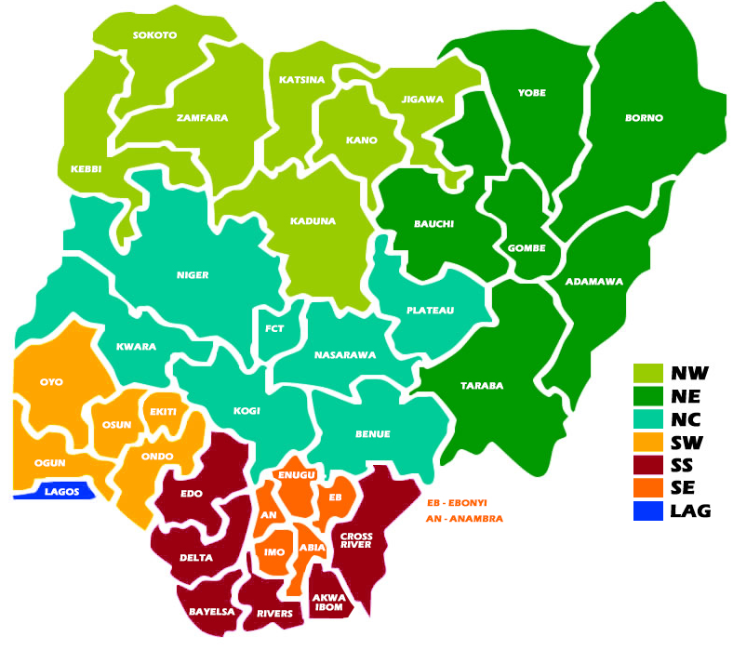
The NCC Licensed InfraCos (Cont.)
Figure 1: A map of the licenced Infracos
7

Slide 8
Recap on Engagements
  The NCC has made presentations to the National Economic Council (NEC) and the Nigerian Governors Forum (NGF) on its Broadband initiatives.
  Engagements with NEC
    On May 17, 2018, the Commission in collaboration with the National industrial Policy and Competitiveness Advisory Council (The Council) made a presentation to the NEC on improving Broadband Penetration.
    In the presentation, the NCC highlighted key issues that need to be resolved to improve Broadband Penetration; Notable amongst is Right of Way (RoW) and Security of ICT infrastructure.
    Also, the NCC made prayers on the key issues.

Slide 9
Recap on Engagements (Cont.)
  Engagement with NGF:
    Furthermore, On June 27, 2018, the Commission made a presentation to Nigerian Governors Forum (NGF) on Broadband Deployment in Nigeria.
    In the presentation, the NCC highlighted the encumbering challenges in the deployment of Broadband Infrastructure in Nigeria, which amongst others include; high RoW charges, multiple regulation & taxation, and delay in obtaining site acquisition permits.
    Therefore, the Commission appealed to the NGF that our prayers (as approved by NEC), especially on the hamonization of N145/m RoW charges, be given the maximum priority it deserves to enable us mitigate the Broadband Infrastructure challenges, so as to achieve the much needed ICT infrastructure for social and economic transformation of our country.

Slide 10
Recap on Engagements (Cont.)
    Prayers to NGF are on:
  Ensuring compliance to NEC’s resolution om harmonization of Right of Way charges on State Government highways with the Federal at the cost of N145/m,
  Assigning a Single Point that will approve RoW applications,
  Limiting the approval process on RoW to a maximum of 30 working days,
  Mandating the installation of utility ducts on road shoulders and buildings during construction and rehabilitation,
  Elimination of Multiple Taxation, and
  Elimination of Multiple Regulations.

Slide 11
Update on InfraCos
  Submission made by the six licensed InfraCos relating to the Capital cost (Capex) for the project for four years, subsidy requirement, network design and roll out plan were reviewed.
  There is a subsidy provision created in the 2017 Budget to the tune of N3 billion and a plan for more in subsequent budgets of the NCC.
  The Capex submissions were found to be high, based on the network design assumptions of multiple PoA’s per LGA and other equipment costs.
  InfraCos were requested to submit revised financials, network design and rollout plan based on, one PoA per LGA only for subsequent review.
  Four out of the six InfraCos have re-submitted their new financials as requested, review has begun towards the negotiation of % subsidy to be considered for their respective zones.

Slide 12
Update on InfraCos (Cont.)
  5. At the end of the subsidy negotiation, Subsidy Agreement Documents shall be signed to kick start the project for each zone. The subsidy negotiation and signing of Subsidy Agreement are currently ongoing.
  6. The re-advertisement of North Central which was earlier licensed under Phase 1, but declined by the licensee, is still undergoing procurement compliance processes before it is advertised. These processes and re-advertisement are to be completed before the end of October, 2018.
  7. Based on the speed of re-submission received from the respective InfraCos and the conclusion of the subsidy agreement, it is expected that the project will kickoff before the end of 2018.

Slide 13
Update on Other
Recommendations of the Council
  Agree and implement wholesale and retail data services pricing framework.
  To conclude by October 2018, the cost-based study on transmission cable pricing, to determine wholesale price of leased capacity link (fibre optics) among the operators.
  A cost-based study on retail broadband and data services, to determine retail tariff for broadband as well as data price floor for internet services for the industry to be concluded by October 2018.

Slide 14
Update on Other
Recommendations of the Council (Contd.)
  2. To grant permit and incentivize infrastructure & Collocation Sharing Licensees (“tower companies”) to connect base stations by fibre.
  The Commission has granted license to IHS (Collocation Licensee) to connect the base stations it is managing with fibre.
  Other Collocation Service providers are also encouraged to apply for the licence granted to IHS.

Slide 15
Challenges
  Confirmation and implementation of the harmonized RoW charges, including one stop shop for approvals within a maximum of 30 days.
  Huge Capital Funding outlay for the project.

Slide 16
Conclusion
The NCC has licensed six out of the seven InfraCo Zones in the country as part of its mandate to drive the deployment of Broadband Infrastructure to the overall growth of the states and the nation at large.
The Commission in collaboration with The Council has made presentations on the NCC broadband initiative, the InfraCo, to the NEC and the NGF.
In the respective submissions, the NCC highlighted key issues that need to be resolved to improve Broadband Penetration and the deployment of Broadband Infrastructure in Nigeria.
As a matter of necessity, the Commission has reviewed the Capex submissions of the six licensed InfraCos. Arising from the review, the InfraCos were requested to submit a review Capex based on one PoA per LGA.
The Commission is expecting the InfraCo project to kickoff by the Q4 2018.

Slide 17
Thank You
Prof. U.G. Danbatta FAEng, FNSE, FRAES
ugdanbatta@ncc.gov.ng

