Slide 1
FACILITATING BROADBAND PENETRATION FOR SOCIAL AND ECONOMIC TRANSFORMATION BY ENGR. PROF. U.G. DANBATTA, FNSE, FRAES Executive Vice Chairman/Chief Executive Officer Nigerian Communications Commission PRESENTATION AT THE FORMAL INAUGURATION OF THE NIGERIAN SOCIETY OF ENGINEERS (NSE), KABUGA BRANCH KANO ON 4TH NOV., 2017.

Slide 2
OUTLINE
Introduction
Broadband Ecosystem
Benefits of Broadband
Broadband Importance
Facilitating Broadband Penetration
Broadband As An Enabler
Impacts of Broadband
Role of Government
Nigeria’s Broadband Space
Scorecards
Conclusions

Slide 3
INTRODUCTION
Broadband is a high speed internet connection through the communications network that connects end users at a high data transfer rate (example Nigeria’s broadband speed remains at 1.5 Mbps).
This definition of broadband is popular, however it is incomplete as broadband is more than a network. Justifiably, broadband is an ecosystem that comprises of different elements.
Broadband transforms the way essential services are delivered from e-health to e-education to e-commerce to e-government.

Slide 4
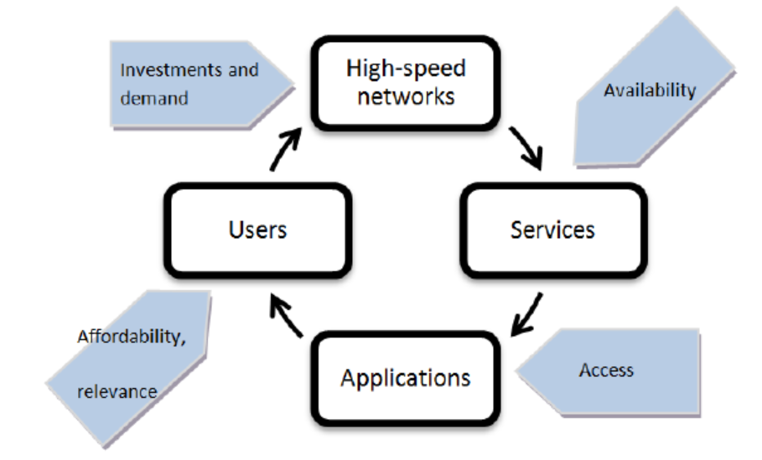
THE BROADBAND ECOSYSTEM
Broadband as defined by the World Bank is an interconnected, multilayered ecosystem that comprises different elements that use high-speed connectivity to interact in different ways. These elements are networks, services, applications and users.
Networks are high-speed, high-capacity communications networks,
Services are bandwidth-intensive services focused on providing high-speed data connectivity that the networks carry,
Applications are the enterprises (software's) that use broadband services to deliver information (content) to users and
Users have the ability to access, create and share information (content).
Connecting the elements of broadband ecosystem [Source: World Bank “Building broadband: Strategies and policies for the developing world”]

Slide 5
THE BROADBAND ECOSYSTEM (CONT’D)
The broadband ecosystem has two (2) major layers; i.e. supply and demand. These layers have spurred broadband access and use through technological, business and market development.
Demand:
The users today are demanding high-speed in up- and down-links for bandwidth-hungry services, while applications are demanding high-capacity networks to satisfy a larger number of users at high-speed.
Supply:
The supply of broadband is driven by the number of users that are simultaneously accessing, creating and sharing content (information) and applications that requires more bandwidth.

Slide 6
THE BROADBAND ECOSYSTEM (CONT’D)
The broadband demand and supply chains have produced better results through:
Access of high-speed networks and services by users and application providers,
Availability and affordability of high-quality applications that attracts more users, and
Users and applications demand growth that drives investments and opportunities.

Slide 7
BENEFITS OF BROADBAND
ITU identifies three (3) benefits of broadband; faster speeds than previous technologies, economic gains, and enhances existing internet applications, while paving the way for new solutions.
World Bank recognizes broadband as “a powerful tool for the delivery of essential services such as education and health, offers increased opportunities for women’s empowerment, environmental sustainability, and continued to enhanced government transparency and accountability”.
The Organization for Economic Co-operation and Development (OECD) identifies broadband as a general purpose, enabling technology for structural changes in the economy, and consider it networks as integral part of the economy.
According to UNESCO and ITU, “The real power of broadband lies in its potential to improve development outcomes in the developing world on the basis of human rights, social inclusion and poverty eradication”.

Slide 8
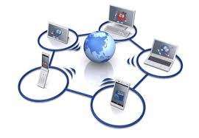
BROADBAND IMPORTANCE
Over the years, broadband has emerged as a powerful general-purpose technology that has driven widespread changes in the Information and Communications Technology (ICT) sector and influenced innovation across other sectors such as education, transportation, health, financial services and government.
Essentially, broadband has made access to information better, which makes work more efficient, thereby expanding productivity & competition, improves quality of service provision & delivery and enhanced government transparency & accountability.
The ITU identifies broadband networks as networks that offer conceivably the ultimate opportunity to make rapid and solid advances in global social and economic transformation and development.

Slide 9
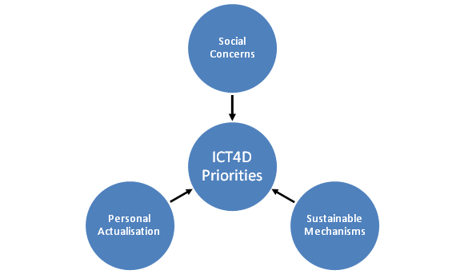
BROADBAND IMPORTANCE (CONT’D)
Broadband as an ecosystem is the appropriate tool for use in ICT for Development (ICT4D), which focuses on bridging the digital divide. Largely, broadband ensures access to up-to-date communications technologies at the requisite speed and capacity. Areas where broadband is applicable to ICT4D include;
Promote digital literacy to aid distance learning,
Development of local content, and
Establishing and enabling digital economy.
Therefore, broadband networks need to be considered as basic critical infrastructure, like water, railways, roads and power networks.

Slide 10
FACILITATING BROADBAND PENETRATION
Broadband revolution is aspired globally, because pervasive access to broadband triggers remarkable change of a nation’s economy, notable amongst include; increase in productivity, creation of innovative new businesses & services, agricultural best practices, job creation and good governance.
World Bank studies show that a 10 % increase in broadband penetration in developing countries accelerate economic growth by 1.38 %.
A joint study conducted by Ericson, A.D. Little and Chalmers University of Technology conclude that “doubling the broadband speed for the economy increases Gross Domestic Product (GDP) by 0.3 %”.

Slide 11
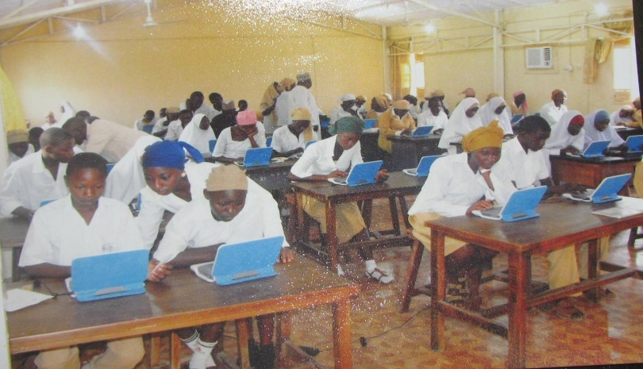
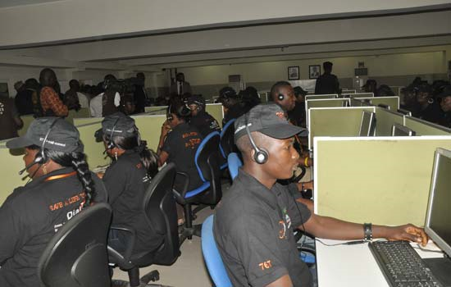
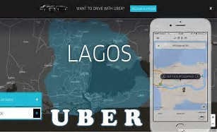
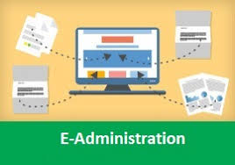
BROADBAND AS AN ENABLER
Broadband as an enabler is transforming societies through:
E-education
E-health
E-government
E-transport
E-commerce
Broadband is modernizing administrative burdens and processes through E-government and E-administration respectively.
Broadband is enhancing and bridging gaps (between urban and rural communities) in education, health, transport and financial services through E-education, E-health, E-transport and E-finance.
E-administration

Slide 12
IMPACTS OF BROADBAND
Broadband has thriven in diverse areas of the global economy, which includes:
Broadband
Productivity effect
Contribution to GDP
Emergence of new services and industries.
Consumer surplus
Improve Informational mobility
Enhanced social interactions
Empowering SMEs
Improving Quality of life
Technology enabler
Enabling globalisation of services

Slide 13
ROLE OF GOVERNMENT
To maximize the multiple economic benefits of broadband, government’s must create friendly policies that will woe investors in the telecommunications market space.
The World Bank has identified government policy support as essential for new market entrants to compete effectively with dominant incumbents. This will aid broadband diffusion and deepen its penetration.
Arising from the government policy, the regular assigned responsibility of implementation of the policy must develop a cohesive framework and strategies that addresses the challenges associated with deployment of ubiquitous broadband infrastructure, amongst include:
Right of ways
Infrastructure sharing
Multiple taxation
Multiple regulation
Vandalism of infrastructure
Infrastructure deployment in unserved and underserved areas

Slide 14
NIGERIA’S BROADBAND SPACE

Slide 15
KEY-IN
The Nigerian government recognizes the immense benefits and importance of broadband and therefore introduces a policy document Nigerian National Broadband Plan (NBP) for fiscal years 2013 to 2018 in line with the ITU and UNESCO policy recommendations of broadband.
The NBP is a means of promoting broadband as a foundation for sustainable development.
The NCC was assigned the responsibility of developing and implementing regulatory frameworks for broadband roadmap enshrined in the NBP.
The NCC, under my stewardship, deliberately developed a strategic vision plan (SVP) (2015 – 2018) to ensure the attainment of 30% broadband penetration by 2018, amongst others.
The Commission unveiled the SVP in Lagos and Kano on 27th Jan 2016 and 12th Feb 2016 respectively.

Slide 16
THE 8–POINT AGENDA
The 8-point Agenda of NCC
8-Point Agenda
8. Ensure Regulatory Excellence & Operational Efficiency
7. Promote Fair Competition and Inclusive growth
6. Protect & Empower Consumers
5. Facilitate Strategic Collaboration & Partnership
4. Promote ICT Innovation & Investment Opportunities
2. Improve QoS
1. Facilitate Broadband Penetration
3. Optimize Usage & Benefits of Spectrum
Facilitate Broadband Penetration is the first on our SVP, which reaffirmed the importance we attached to pervasive access to broadband to all citizens of our dear nation.

Slide 17
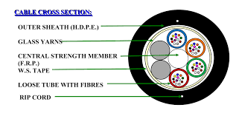
STRATEGY TO FACILITATE BROADBAND PENETRATION
The strategy adopted by the Commission to facilitate broadband penetration includes:
Licensing of Infrastructure Companies (Infracos)
Spectrum
Attracting Investments
Abridging Access Gaps
Stakeholder engagement

Slide 18
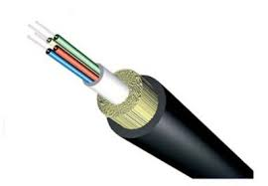
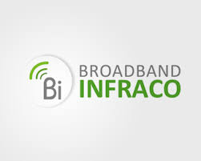
LICENSING OF INFRASTRUCTURE
COMPANIES (Infracos)
The Open Access Model has been identified by the NCC as the model to abridge the gap between existing and planned Fiber infrastructure in Nigeria.
The Commission, therefore, established a Broadband Implementation & Monitoring Committee (BIMC) to drive the licensing of broadband infrastructure companies and deployment using the Open Access Model..
Presently, BIMC is concluding the Phase 1 of the Infrastructure provision licenses awarded for the Lagos and North Central Zones.
Furthermore, the NCC is also finalizing the Phase II project in the remaining five zones; North-East, North-West, South-East, South-South and South-West.

Slide 19
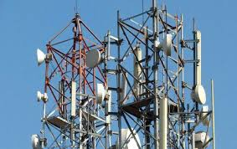
SPECTRUM
Despite the overwhelming reliance on mobile access, the Commission is currently reviewing its spectrum licensing framework to accommodate stakeholders’ needs.
Consultations have commenced on spectrum trading, active infrastructure sharing and re-farming of available spectrum resources.
We are working with the National Frequency Management Council (NFMC) on harvesting the digital dividend spectrum for broadband deployment.

Slide 20
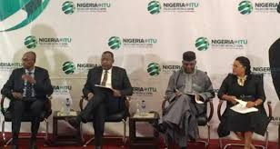
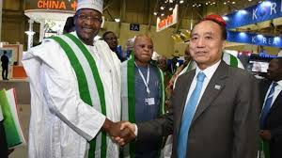
ATTRACTING INVESTMENTS
Nigeria has since witnessed a great increase in the number of market players, unprecedented growth in the networks, the empowerment of the Nigerian citizens, job creation, economic stimulation, and substantial increase in access to ICT.
This has been achieved through NCC’s commitment to fair and transparent regulation.
For this, The NCC has reached an advanced stage in the implementation of a Code of Corporate Governance for the industry that will strengthen telecoms legal entities and attract investment.
Furthermore, the Commission engages investors in different fora to attract Foreign Direct Investments (FDI).
I have made presentations at key events like the ITU Telecom World 2016 & 2017, World Summit on Information Society 2016 and GSMA World Congress in order to attract FDI in the sector.

Slide 21
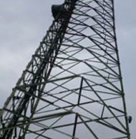
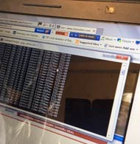
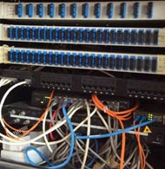
ABRIDGING ACCESS GAPS
NCC through the Universal Service Provision Fund (USPF) is bridging the access gaps by facilitating and extending broadband services to the underserved and unserved communities through its connectivity programme.
The connectivity programme comprises telecoms infrastructure projects that are implemented through a Public Private Partnership Model, which includes, Base Transceiver Stations (BTSs), Rural Broadband Initiative (RUBI), University Inter-Campus Connectivity (UnICC) and Backbone Transmission Infrastructure (BTRAIN).

Slide 22
STAKEHOLDER ENGAGEMENT
The NCC within its mandate engages stakeholders’ of the telecommunications industry in addressing the challenges bedevilling the industry.
These challenges include:
Multiple taxation and Multiple Regulation,
Right of Way (RoW),
Electric Power Supply,
Vandalism of Infrastructure and
Foreign Exchange.

Slide 23
MULTIPLE TAXATION & MULTIPLE REGULATIONS
MULTIPLE TAXES
The Commission through its Industry Working Group (IWG) on Multiple Taxation and Multiple Regulation continues to maintain dialogue with organizations regarded as major players at the Federal, States and Local Government Areas to stop the further imposition of different taxes, fees and charges on telecoms operators.
The Commission at the Governors forum made a presentation, drawing the attention of the State Governors to the National Economic Council’s resolution on multiple taxation and multiple regulations on deployment of telecoms infrastructure.
Abiding by these resolutions will energize the economic activities in the states and attract investments.

Slide 24
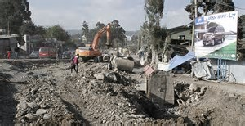
RIGHT OF WAY (ROW) (CONT.)
The Commission was able to secure the support of the Government of Ogun State, to unseal 47 Base Transceiver Stations (BTSs) shut down by an agency of the state government and
Reduction of ground rent for BTSs from N360 million to N120 million in favour of Integrated Holding Services (IHS) Towers.
The Commission intervened with respect to RoW issues for deployment of fiber infrastructure in Kano State,
The Commission amicably resolved the RoW issues regarding two (2) federal roads (Zaria and Maiduguri Roads) in Kano between the State Government and MTN Nigeria Communications Limited.
Furthermore, the Commission secured a permit fee waiver of a whopping N221 million in favour of MTN.

Slide 25
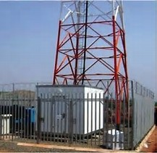
ELECTRIC POWER SUPPLY
Electric power supply is a major setback in the drive towards enhancing quality of service in the telecommunications industry.
The situation, placed additional operational costs on telecoms operators with the attendant adverse impact of slow investment in building new BTSs and other infrastructure in the industry,
The Commission, as part of its responsibilities continues to engage in discussions with telecoms operators and co-location service providers on how to ameliorate the burden of the huge investments in running their BTSs on generating sets.

Slide 26
VANDALISM OF
INFRASTRUCTURE
The Commission continues to:
Collaborate with the Federal Government to provide adequate security to telecoms facilities.
Engage communities on the need to protect telecoms infrastructure through various platforms such as Town Hall meetings, Telecom Consumer Parliaments and other outreach programmes.
The NCC has commenced activities that would lead to the establishment of a ‘Critical National ICT Infrastructure Bill’.
When this bill is passed into law, government would classify telecoms infrastructure as the critical national infrastructure, which will enjoy priority protection in the country, as well as specify definite sanctions for willful destruction of Information and Communications infrastructure.

Slide 27
FOREIGN EXCHANGE
The telecommunications operators are facing difficulties in accessing foreign exchange (Forex) for the deployment of telecommunications services in the country.
In addressing the Forex challenges, the Commission has engaged the CBN management and to that effect, the CBN agreed to include telecommunications as part of the CBN priority list for accessing the Forex. This has reduced the Forex burden on the telecom operators.

Slide 28
SCORECARDS

Slide 29
BROADBAND PENETRATON
Active Mobile-Broadband Penetration
Table 1: Nigeria’s Active Mobile-Broadband Subscriptions (MBS) % Penetration 2015 to 2017.
YEAR | MBS/100
2015 | 8
2016 | 20.95
2017 | 21.8
Figure 1: Nigeria’s Active Mobile-Broadband Subscriptions (MBS) % Penetration 2015 to 2017.
[Source: ITU-UNESCO Broadband Commission for Sustainable Development (2017)]
After the implementation of the SVP, Nigeria’s Active Mobile-Broadband Penetration has increased within the space of two years from less than 10% in 2015 to 20.95% in 2016 and 21.8 % in 2017 indicating consistent growth.
Engr. Prof U.G. Danbatta
29
4

Slide 30
INTERNET PENETRATON
Percentage of Households with Internet (PHI) and Individuals Using Internet (PII) Penetration
Table 2: Nigeria’s Percentage of Households with Internet (PHI) and Individuals using the Internet (PII) 2016 to 2017.
YEAR | PHI | PII
2016 | 11.40 | 47.44
2017 | 15.20 | 25.7
Figure 2: Nigeria’s Percentage of Households with Internet (PHI) Individuals using the Internet (PII) 2016 to 2017.
[Source: ITU-UNESCO Broadband Commission for Sustainable Development (2016)]
Nigeria’s Internet Penetration (PHI and PII) stabilizes in two (2) years because of the active implementation of the SVP, which has triggered the growing trend of accessing the Internet exclusively via mobile devices (smartphones and tablets).
Currently, Nigeria has the highest Mobile Share of Web traffic of more than 80%.
Engr. Prof U.G. Danbatta
30

Slide 31
CONTRIBUTION TO GDP
Quarter | 1st Qtr, 16 | 2nd Qtr, 16 | 3rd Qtr, 16 | 4th Qtr, 16 | 1st Qtr, 2017
Value Cont.(Million) | N1,411,743.39 | N1,580,140.43 | N1,398,963.43 | N1,662,816.04 | N1,452,572.74
% Contribution | 8.85 | 9.74 | 7.97 | 9.13 | 9.16
The share of Nigeria’s telecoms sector in total GDP has stabilised in the last six quarters as released by the National Bureau of Statistics (NBS) report.
In the First Quarter (Q₁) of 2017, the telecoms sector contributed N1.452 trillion to the GDP, i.e. 9.16 %. This is an increase of 0.2% compared to the First Quarter of 2016, indicating stable growth in the sector .

Slide 32
ATTRACTING INVESTMENTS (CONT.)
FDI in the telecommunications sector for the period January 2015 to December 2016
2015 |  | 2016
MONTH | AMOUNT USD | MONTH | AMOUNT USD
January | 304,696,754.21 | January | 704,201.00
February | 8,574,565.70 | February | 6,979,892.37
March | 29,094,209.47 | March | 5,756,476.84
April | 56,172,318.10 | April | 47,378,265.66
May | 76,740,520.82 | May | 28,301,431.66
June | 5,807,621.70 | June | 67,018,269.50
July | 241,252,359.51 | July | 4,256,309.10
August | 20,576,281.64 | August | 118,123,478.35
September | 107,663,500.62 | September | 122,420,006.76
October | 60,920,848.51 | October | 319,292,120.37
November | 20,166,606.92 | November | 90,346,697.08
December | 12,280,619.15 | December | 144,609,849.65
Total | 943,946,143.35 | Total | 955,186,998.34
Trend and % | Increase - 1.19 %
From the Table, FDI has been stable in the last two (2) years with slight increase of 1.19 %.
This is as result of engagement with targeted international partners and potential investors, which has further raised the profile of the Commission and the telecoms sector at large.

Slide 33
CONCLUSIONS
Broadband is completely transforming the way essential services are delivered from e-health to e-education to e-commerce to e-government.
The Nigerian government has key-in in the provision of broadband services to its citizens with the introduction of a policy document Nigerian National Broadband Plan (NBP) for fiscal years 2013 to 2018 in line with the ITU policy recommendations of broadband.
The NCC as an agency of government has been resolutely committed to the rapid and a pervasive deployment of broadband networks and services in the country.

Slide 34
CONCLUSIONS
The EVC developed the Strategic Vision Plan (SVP) for fiscal years 2015 to 2020 to ensure that the ICT infrastructure are to the standard necessary to provide ubiquitous broadband services in Nigeria.
Despite challenges affecting the telecoms industry, within the space of two (2) years after the implementation of the SVP, quantitative results shows that, Active Mobile-Broadband Penetration has increased within the space of two (2) years from less than 10% in 2015 to 21.8% in 2017.
The contribution of the telecommunications sector in the first quarter of 2017 is N1.452 trillion to the GDP, i.e. 9.16 %. This is an increase of 0.2% compared to the First Quarter of 2016, indicating stable growth in the sector.

Slide 35
THANK YOU
Engr. Prof. Umar Garba Danbatta, FNSE, FRAES
ugdanbatta@ncc.gov.ng
Engr. Prof U.G. Danbatta
35

