Slide 1
HEALTH IMPLICATION OF THE MOUNTING OF TELECOMMUNICATIONS MAST CLOSE TO BUILDINGS
Presentation to the House of Representatives Ad-Hoc Committee to Investigate the Health Implication of the Mounting of Telecommunications Mast Close to Buildings
By
Nigerian Communications Commission (NCC)

Slide 2
OBJECTIVES OF THIS PRESENTATION
To provide information to the Honourable Members on the safety of telecommunications (telecoms) infrastructure.
To allay any health concerns and misconceptions on radiation from telecoms masts.
To assure Honourable Members that radiation emanating from mobile networks within the specified limits is not harmful.

Slide 3
INTRODUCTION
Explosive growth in the Telecommunication industry in Nigeria
The industry has grown from a teledensity of 0.45% in 2001 to 110% in 2016.
Well above 150,000,000 (One Hundred & Fifty Million) active lines

Slide 4
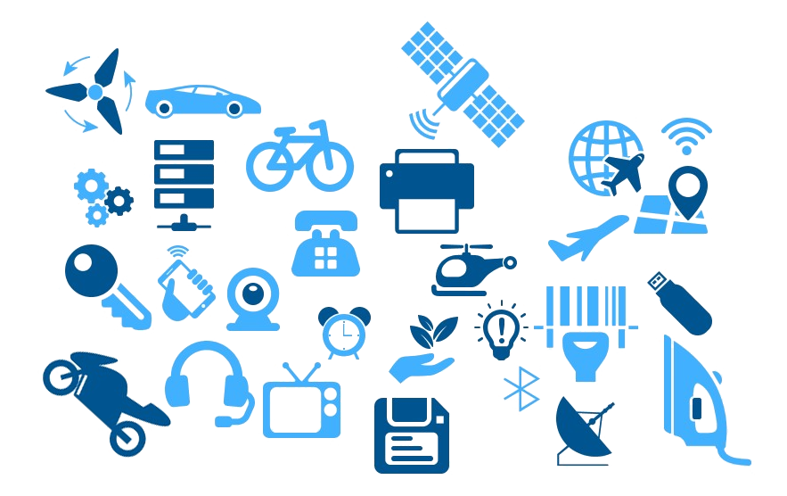
INTRODUCTION CON’T
There are about 7 billion mobile subscriptions globally.
By 2020, we expect that nearly everything will be connected, with an estimated 50 billion connected devices.

Slide 6
COUNTRY BENCHMARK STATISTICS
 | Nigeria | India | United States | United Kingdom
Area (sq. km) | 923,768 | 3,287,263 | 9,833,517 | 243,610
Population (July 2015) | 181,562,056 | 1,251,695,584 | 321,368,864 | 64,088,222
Total Active Lines (July 2015) | 150,741,005 | 1,036,572,000 | 504,298,000 | 113,897,000
Number of Base Stations (2015 est.) | 49,096 | 400,000 | 215,000 | 52,500
Ratio of Subscriptions to Base Stations | 3070.33 | 2591.43 | 2345.57 | 2169.47

Slide 7
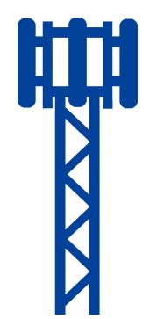
GSM NETWORK COMPONENTS
NMC and OMC
SS
AUC
VLR
HLR
EIR
BSS
MS
Other
Networks
GMSC
MSC
BSC
BTS
SS: Switching System
BSS: Base Station System
Signaling Transmission
Call Connection & Signaling Transmission

Slide 8
BASE TRANSCEIVER STATION (BTS)
More than 50,000 Base Transceiver Stations (BTS) spread across the country.

Slide 9
RADIO WAVES ARE ALL AROUND US …
Broadcast
Tower
Satellite
Sun
Mobile
Phone
WiFi
Router
Radar
Base
Station

Slide 10
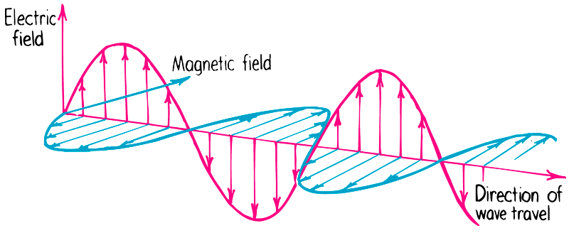
ELECTROMAGNETIC FIELDS (EMF)
What is an Electromagnetic Field (EMF)?
An electromagnetic field consists of waves of electric and magnetic energy moving together through space. Often the term "electromagnetic field" or EMF is used to indicate the presence of electromagnetic radiation.

Slide 11
TYPES OF RADIATION
There are two (2) types of Radiation
Ionizing radiation
Non-ionizing Radiation

Slide 12
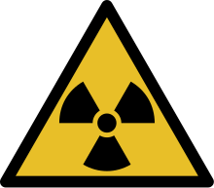
IONIZING RADIATION
Ionizing radiation carries large amount of energy which is enough to ionize atoms and molecules, and break chemical bonds.
A common source of ionizing radiation is radioactive materials that emit α (Alpha), β Beta), or γ (Gamma) radiation.
Other sources include X-rays from medical radiography.
In general, ionizing radiation is harmful and potentially lethal to living beings but can have health benefits in radiation therapy for the treatment of cancer and some thyroid diseases.

Slide 13
NON-IONIZING RADIATION
The lower-energy, longer-wavelength part of the spectrum including visible light, infrared light, microwaves, and radio waves is non-ionizing; its main effect when interacting with tissue is heating.
This type of radiation only damages cells if the intensity is high enough to cause excessive heating.

Slide 14
THE ELECTROMAGNETIC SPECTRUM

Slide 15
COMMON SOURCES OF EMF EXPOSURE
FM/AM Radio Stations | TV transmissions | Wireless Networks | Mobile Phones
S/N | EMF Source | Operating Frequency | Radiated Power
1 | AM/FM Stations | 540 KHz – 108 MHz | 1,000 - 30,000 watt
2 | TV Stations | 48 MHz – 814 MHz | 10,000 - 500,000 watt
3 | Wi-Fi | 2.4 – 2.5 GHz | 0.010 – 0.10 watt
4 | BTSs/Node-B | 800, 900, 1800, 2100, 2300 MHz | 20 watt
5 | Mobile Phones | GSM-1800 / CDMA GSM-900 | 1 watt

Slide 16
ICNIRP GUIDELINES
ICNIRP - International Commission on Non-Ionizing Radiation Protection
ICNIRP issues guidelines on the basis of the current scientific knowledge. Based on established biological and heath effects, it provides estimation for occupational and general public exposure.
Most countries (EU, India, Nigeria, etc.) draw on ICNIRP guideline for their own national standards.

Slide 17
SUMMARY FOR ICNIRP GUIDELINE
 | Mobile Phone/Base Station [Unit Power Density (W/m²)]
Frequency | GSM 900MHz | GSM 1800MHz | WCDMA 2100MHz
Public Exposure Limits | 4.5 | 9.0 | 10.0
Occupational Exposure Limits | 22.5 | 45.0 | 50.0

Slide 18
MAST SETBACK FROM DOMICILE BUILDINGS
5m
10m
From 2001 – January 2014
5 metre Setback
(NCC Regulation)
From January 2014 Onwards
10 metre Setback
(NESREA Regulation)

Slide 19
A TYPICAL COMPLIANCE BOUNDARY
For a typical base station and antenna (output power is 20W, antenna gain is 15dBi) and considering general public, the area outside about 4m diameter around antenna is safe.
4 m
A typically configured base station antenna
Compliance bound
according to ICNIRP
power density Limit

Slide 20
ACTUAL DEPLOYMENT CONDITIONS
The minimum height for the installation of radio antenna is 24 metres.
Minimum distance from base of a telecoms mast to a domicile is 10 metres.
ICNIRP Compliance boundary is 4 metres.
26m
24m
10m

Slide 21
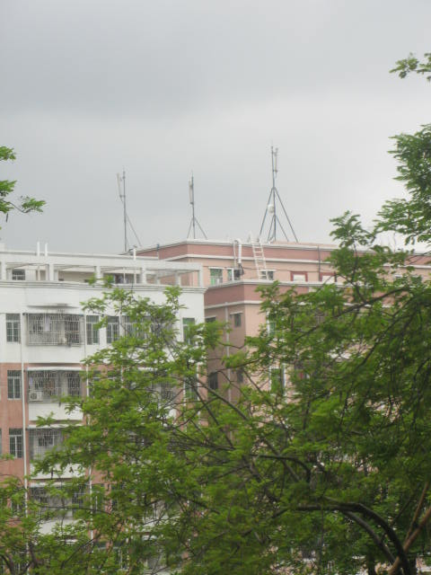
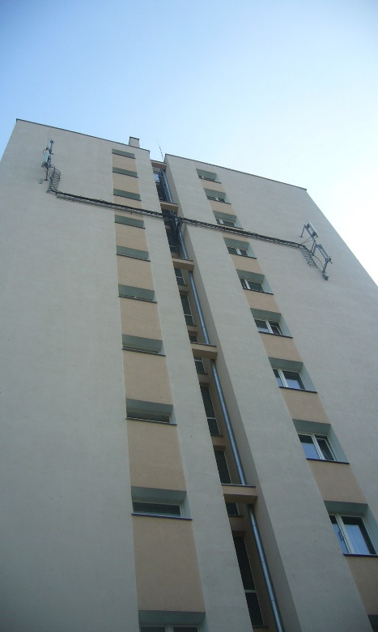
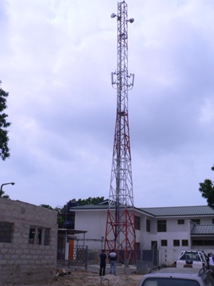
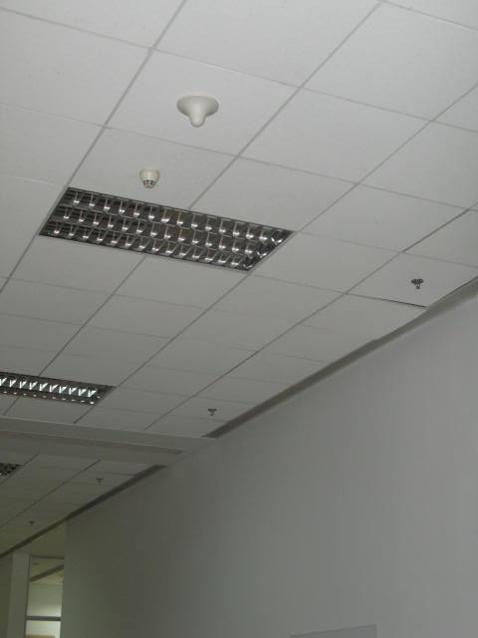
BASE STATIONS INSTALLATIONS
Base Stations and Associated Antennas are installed …
On the building rooftop
On the external
wall of the
building
On the tower/mast
Sometimes even
in the office
ceiling!

Slide 22
ANTENNA MAP OF NEW YORK CITY

Slide 23
ANTENNAS ON BUILDINGS (NEW YORK CITY)

Slide 24
WORLD HEALTH ORGANISATION (WHO)
What is the position of WHO on EMF Radiation from GSM Equipment?

Slide 25
MOBILE PHONES AND HEALTH
In regards to mobile phones and health, the WHO notes that:
“A large number of studies have been performed over the last two decades to assess whether mobile phones pose a potential health risk. To date, no adverse health effects have been established as being caused by mobile phone use.“
SOURCES
1. WHO Fact Sheet 193 June 2011

Slide 26
BASE STATIONS AND HEALTH
With respect to base stations and health, the WHO notes that:
“Considering the very low exposure levels and research results collected to date, there is no convincing scientific evidence that the weak RF signals from base stations and wireless networks cause adverse health effects."
"Studies to date provide no indication that environmental exposure to RF fields, such as from base stations, increases the risk of cancer or any other disease.“
SOURCES
WHO Online Q&A September 2013
WHO Backgrounder 2006

Slide 27
BASE STATIONS AND HEALTH
Conclusions by Other Experts
In summary, although a substantial amount of research has been conducted in this area, there is no convincing evidence that RF field exposure below guideline levels causes health effects in adults or children.
http://www.hpa.org.uk/webw/HPAweb&HPAwebStandard/HPAweb_C/1317133826368
The results of current scientific research show that there are no evident adverse health effects if [EMF] exposure remains below the levels set by current standards.
http://ec.europa.eu/health/scientific_committees/emerging/docs/scenihr_o_041.pdf
UK Advisory Group on Non-Ionising Radiation (AGNIR)
Scientific Committee on
Emerging and Newly
Identified Health Risks
(SCENIHR )

Slide 28
BASE STATIONS AND HEALTH
Conclusions by Other Experts (Continued)
… The balance of scientific evidence to date still does not indicate that harmful effects occur in humans due to low-level exposure to EMFs.
http://www.theiet.org/factfiles/bioeffects/emf-position-page.cfm
… With respect to cell phone towers, as long as exposures respect the limits set in Health Canada’s guidelines, there is no scientific reason to consider cell phone towers dangerous to the public.
http://www.hc-sc.gc.ca/hl-vs/alt_formats/pacrb-dgapcr/pdf/iyh-vsv/prod/cell-eng.pdf

Slide 29
NCC STRATEGIES FOR MINIMIZING EFFECTS OF RADIATION
Strategies
Practical Field Measurement of EMF
BTS Site Approvals
Results of expert studies by WHO, ICNIRP, GSMA, etc.
Equipment Type Approval

Slide 30
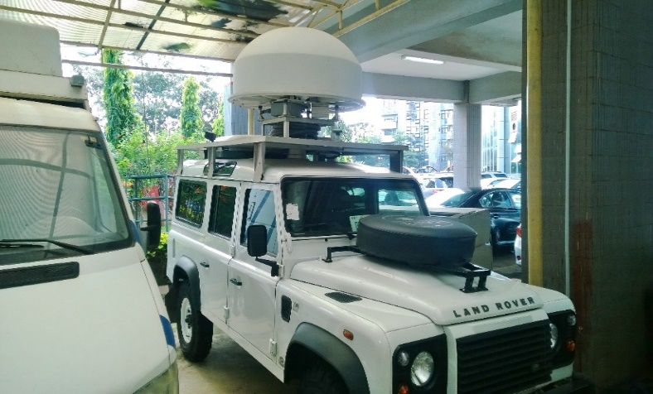
PRACTICAL FIELD MEASUREMENTS
The NCC, in the pursuance of its regulatory functions in ensuring compliance with acceptable environmental, public health and safety standards, conducts regular measurements of EMF on BTS across the country.
The results obtained revealed that measured radiation levels are far below ICNIRP permissible levels for occupational staff and the general public.

Slide 31
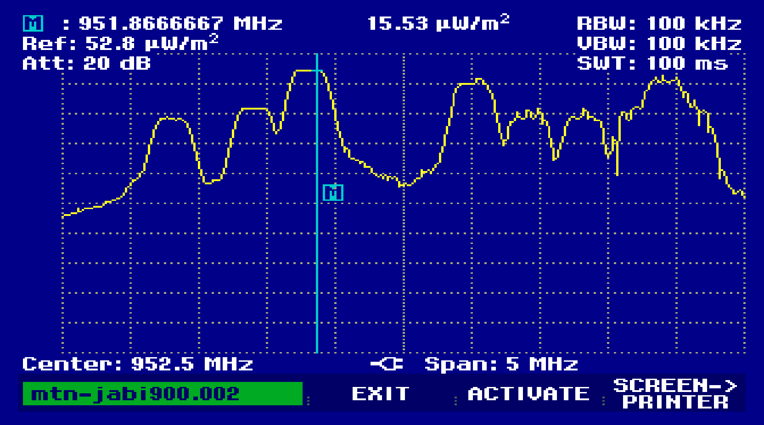
TYPICAL POWER DENSITY (Watt/m²) MEASUREMENT
The signal trace shown below is a typical measured power density value of 15.53µwatt/m² on the 900 MHz band.

Slide 32
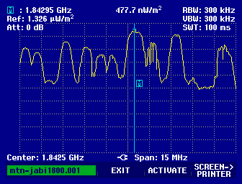
TYPICAL POWER DENSITY (Watt/m²) MEASUREMENT
Similar signal trace on the 1800 MHz band is shown below with a measured power density value of 477.7 nwatt/m².

Slide 33
COMPARISON BETWEEN MEASURED VALUES AND ICNIRP LIMITS ON POWER DENSITY
Frequency | General Public Limit | NCC Measured Value (Public Limit) | Percentage
900 MHz | 4.5w/m² | 0.00001553w/m² | 0.0003451%
1800MHz | 9.0w/m² | 0.0000004777w/m² | 0.0000053%

Slide 34
ELECTRIC FIELD STRENGTH MEASUREMENTS
In a typical field measurement exercises, the strongest measured field strength taken at the closest distance to the tower was 2.2v/m, representing 7.5% of the minimum reference level of 29v/m specified by ICNIRP.
The very low signal strength shows that BTS installations pose no risk to the health and safety of humans.

Slide 35
COLOCATION SITE – Utako, Abuja
Distance | Reference level for Electric-Field Strength (V/M) | Measured Value of Electric-Field Strength (V/M) at BTS site location. |  |  | Remarks
 | ICNIRP | Peak Value | Pulse Value | Average Value
10m | 29 – 61 | 1.20 | 0.80 | 0.80 | The maximum value of 1.20V/M (Peak value) represents 4.1% of the minimum Electric-Field Strength reference level i.e. 29V/M. Hence Measured Values are below the minimum Limits (29V/M)
20m | 29 – 61 | 0.90 | 1.20 | 1.00
30m | 29 – 61 | 1.10 | 0.70 | 0.70
40m | 29 – 61 | 1.00 | 0.60 | 0.40
50m | 29 – 61 | 1.20 | 0.50 | 0.40
60m | 29 – 61 | 1.10 | 0.50 | 0.40

Slide 36
COLOCATION SITE - Karkasara, Kano.
Distance | Reference level for Electric-Field Strength (V/M) | Measured Value of Electric-Field Strength (V/M) at BTS site location. |  |  | Remarks
 | ICNIRP | Peak Value | Pulse Value | Average Value
5 m | 29 – 61 | 0.64 | 0.60 | 0.60 | The maximum value of 1.02 V/M (Peak Value) represents 3.5% of the minimum Electric-Field Strength reference level i.e. 29V/M. Hence Measured Values are below the minimum Limits (29V/M)
10m | 29 – 61 | 0.51 | 0.54 | 0.45
15m | 29 – 61 | 0.76 | 0.62 | 0.56
20m | 29 – 61 | 0.70 | 0.65 | 0.65
25m | 29 – 61 | 0.92 | 0.77 | 0.65
30m | 29 – 61 | 0.84 | 0.86 | 0.76
35m | 29 – 61 | 1.02 | 0.93 | 0.74
40m | 29 – 61 | 0.76 | 0.69 | 0.63
45m | 29 – 61 | 0.83 | 0.75 | 0.66
50m | 29 – 61 | 0.80 | 0.83 | 0.82

Slide 37
COLOCATION SITE - Anifowoshe, Ikeja, Lagos.
Distance | Reference level for Electric-Field Strength (V/M) | Measured Value of Electric-Field Strength (V/M) at BTS site location. |  |  | Remarks
 | ICNIRP | Peak Value | Pulse Value | Average Value
5m | 29 – 61 | 1.80 | 1.50 | 1.69 | The maximum value of 1.80 V/M represents 6.2% of the minimum Electric-Field Strength reference level i.e. 29V/M. Hence Measured Values are below the minimum Limits (29V/M)
10m | 29 – 61 | 0.98 | 0.78 | 0.78
15m | 29 – 61 | 0.54 | 0.53 | 0.54
20m | 29 – 61 | 0.38 | 0.39 | 0.35
25m | 29 – 61 | 0.76 | 0.79 | 0.66
30m | 29 – 61 | 0.73 | 0.50 | 0.50
40m | 29 – 61 | 0.40 | 0.35 | 0.36
50m | 29 – 61 | 0.86 | 0.75 | 0.76

Slide 38
COLOCATION SITE - Akugbo Street, Port Harcourt
Distance | Reference level for Electric-Field Strength (V/M) | Measured Value of Electric-Field Strength (V/M) at BTS site location. |  |  | Remarks
 | ICNIRP | Peak Value | Pulse Value | Average Value
5 m | 29 – 61 | 0.50 | 0.55 | 0.58 | The maximum value of 0.81V/M (Pulse value) represents 2.8% of the minimum Electric-Field Strength reference level i.e. 29V/M. Hence Measured Values are below the minimum Limits of (29V/M)
10m | 29 – 61 | 0.70 | 0.67 | 0.68
15m | 29 – 61 | 0.66 | 0.70 | 0.73
20m | 29 – 61 | 0.55 | 0.62 | 0.65
25m | 29 – 61 | 0.65 | 0.65 | 0.60
30m | 29 – 61 | 0.75 | 0.70 | 0.66
35m | 29 – 61 | 0.75 | 0.70 | 0.75
40m | 29 – 61 | 0.75 | 0.81 | 0.75
45m | 29 – 61 | 0.81 | 0.83 | 0.73
50m | 29 – 61 | 0.75 | 0.81 | 0.75

Slide 39
CONCLUSION
The main conclusion from the WHO reviews and most studies is that, EMF exposures below the limits recommended in the ICNIRP international Guidelines do not appear to have any known consequence on health.
The non-ionizing radiations from BTSs and mobile handsets do not disrupt the molecular structure of biological material in humans.
Please note that BTS radiation scare is a myth and NOT REALITY.

Slide 40
THANK YOU

